Slide 2
CAF -development bank of Latin America and the Caribbean- has partnered with regional institutions to introduce the Transformational Leadership Program 2.0. Our new course focuses on soft skills development, equipping leaders of the region with essential tools to enhance their leadership abilities and foster impactful connections within their communities.
Christian Asinelli Corporate Vice President of Strategic Programming at CAF | “We take pride in launching this renewed training proposal, which aims to bolster public, social, political, and business leadership. Our goal is to empower regional leaders to effectively address the pressing challenges of today.” “We advocate for a brand of leadership that is human-centered, empathetic, and accountable—placing the needs of those in need at the forefront of action. Together, we must ensure that no one is left behind on the journey towards sustainable development.”
ENROLLMENT DATES
START DATE
END DATE
DURATION
REGISTRATION FEE
March 1st to April 26th, 2024
May 6th
October 30th, 2024
6 months (110 hours)
USD 220

Slide 3
Objective
Enhance leadership competencies and soft skills among representatives of civil organizations, as well as leaders from the public and private sectors across Latin America and the Caribbean. This initiative is tailored for individuals who aspire to drive positive change at both national and subnational levels and aim to foster the development of their local communities and territories.
Program focus
Soft skills
Digital transformation
Gender and population groups
Climate change
SDGs and the 2030 agenda
Local government and management
Economic revitalization
BiodiverCities
Financial education
The program is aimed at
Public, social, political and business leaders aged 18+.
*advanced academic formation is not required
Public officials.
NGO representatives and heads of civil organizations.

Slide 4
Methodology
The 6-month program combines a mixed format in which CAF provides students with virtual, on-demand course materials, as well as discussion forums and live online lessons by international experts.
Our partner institutions will impart their classes based on their preferred format (in-person, virtual, or hybrid).
Content distribution
The program will be delivered simultaneously by CAF and our regional allies:
Delivery by CAF - 55 hours (50%) - CANVAS platform
Delivery by UWI - 55 hours (50%) - CANVAS platform
Students who complete their final project in accordance with course guidelines will receive a digital certificate co-issued by CAF and The University of West Indies.
This certificate will be electronically safeguarded, portable and easily shareable.
The program places a strong focus on developing soft skills essential for strong leadership, with topics from CAF’s agenda integrated throughout the curriculum.
Dynamic workshop sessions will enhance students’ learning journey as they collaborate on their final projects and engage with our expert instructors.

Slide 5
Syllabus
Module 1. Leadership Challenges in Today’s World | Towards a new kind of leadership Vocation, leadership and culture Climate change and the SDGs Optional contents for further study
Module 2. Leadership and Personal Development | Leadership and self-knowledge Leadership and the present time Behavioral sciences and change management Optional contents for further study
Module 3. Leadership and Communication | Emotional and social abilities for leadership Effective communication, public speaking and argumentation Team leadership Gender and other population groups Optional contents for further study
Module 4. Leadership and Public Service | Public leadership Government and local management Optional contents for further study
Module 5. Leadership, Projects and Economy | Impact evaluation and projects Leadership and economy
Module 6. Final Projects | Final project workshop

Slide 6
Payment Dates and Fees
Payment deadline: May 3, 2024
The program is valued at US$1,000 per student, and is funded by CAF up to 50%.
All payments should be directed to The University of West Indies Global Campus Trinidad & Tobago using their preferred payment method.
Once your application is accepted, you will receive detailed payment instructions via email.
Reimbursement Policy
Due to financial support provided by CAF towards program development and delivery costs, reimbursements are not available.
Program Learning Resources
To support learning, the program offers the following resources:
Audiovisuals: Videos created by our instructors
Case Studies and Lessons
Interactive Forums
Tests and Exercises
Group Collaborations
Expert Lectures
Reference Bibliography

Slide 7
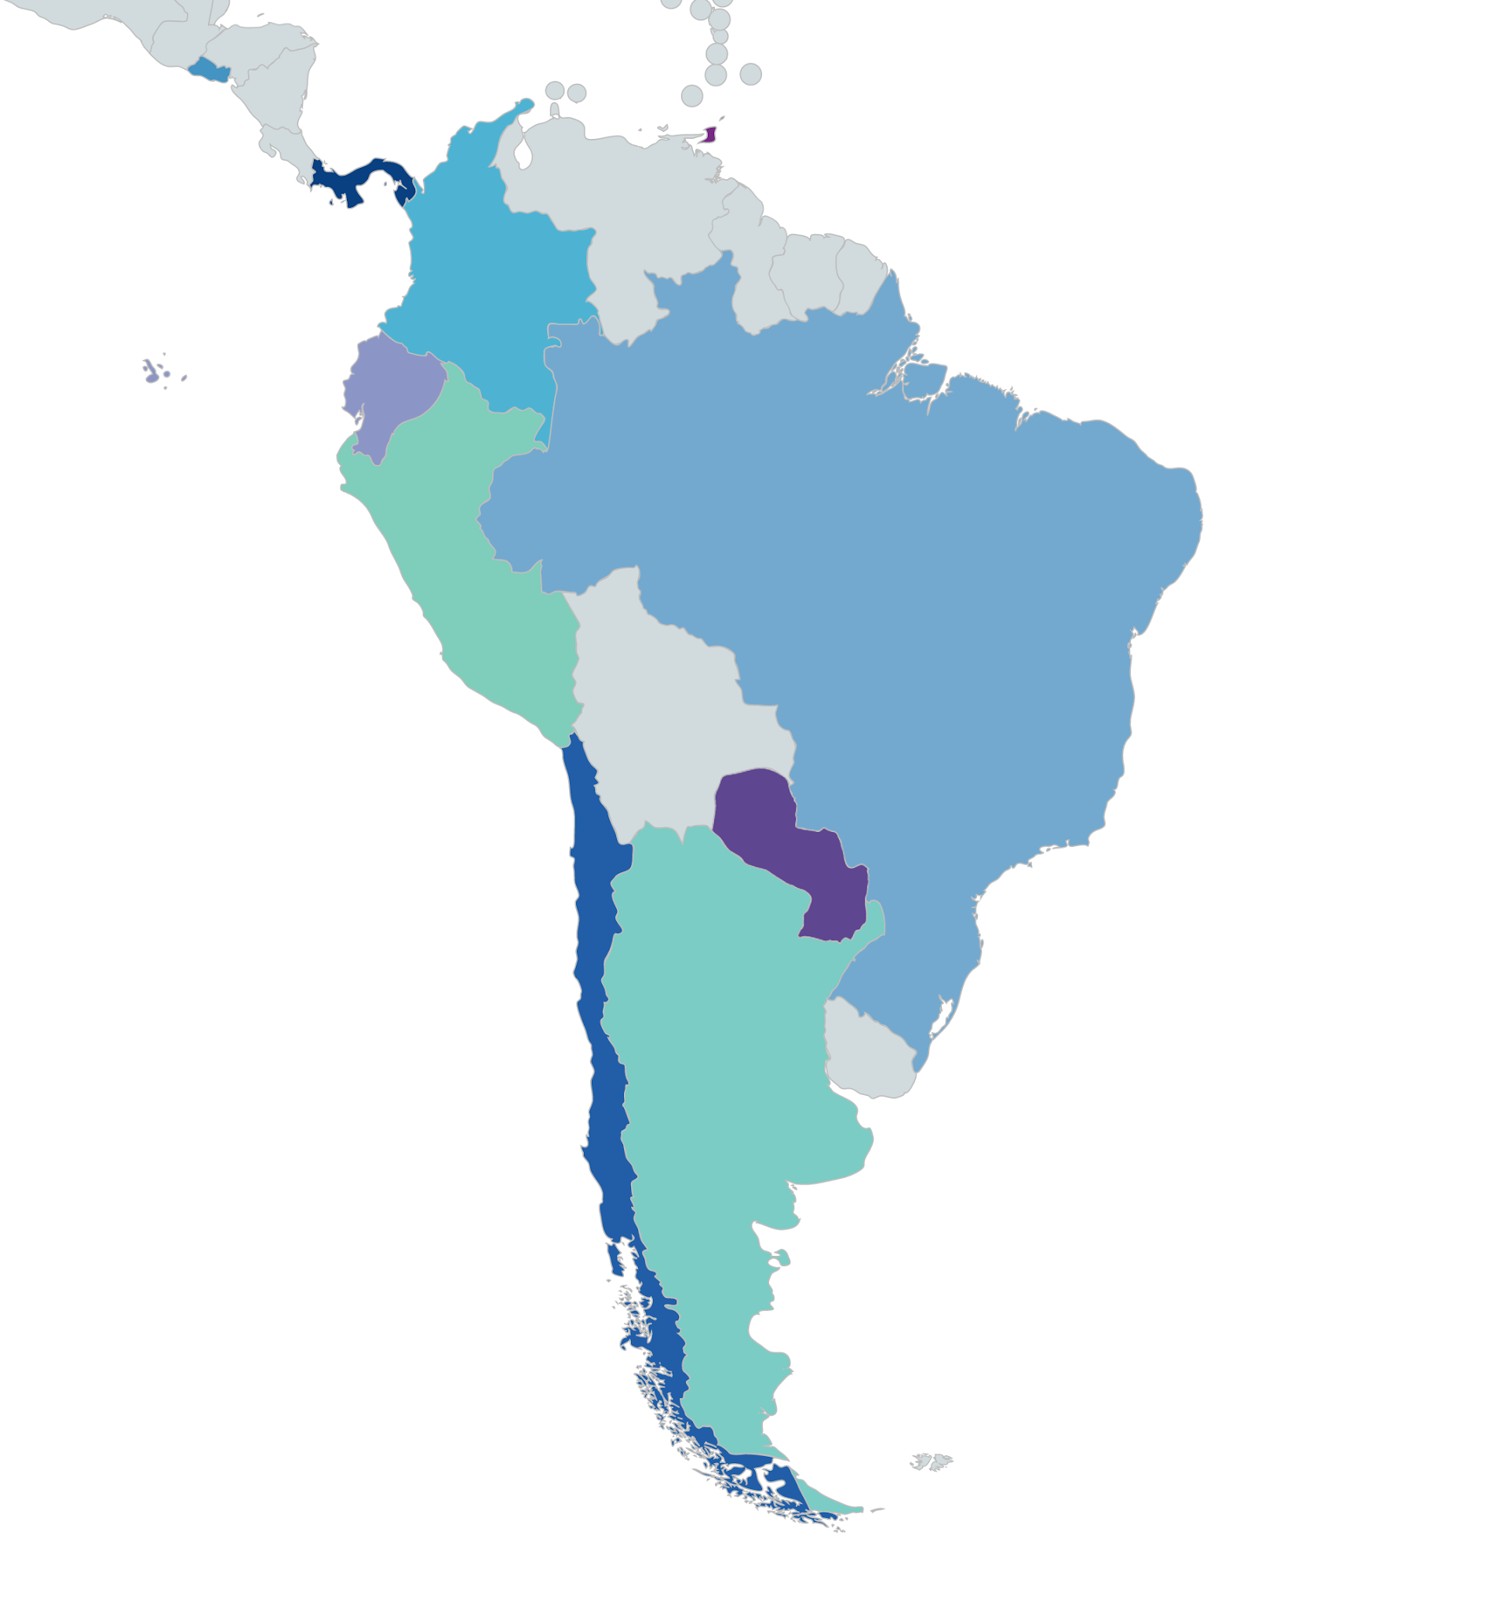
Regional Allied Institutions
This program, developed in partnership with leading institutions in Latin America and the Caribbean, enables students to cultivate a regional perspective and engage in meaningful exchanges of ideas and experiences with peers from various countries.
El Salvador
Panamá
Trinidad and Tobago
Colombia
Brasil
Ecuador
Perú
Paraguay
Chile
Argentina

Slide 8
Inquiries
For any questions related to academic matters, registration, payments, use of the learning platform, or any other concerns, please reach us at:
CAF:
cursosvirtuales@caf.com
The University of West Indies, Global Campus:
programmes.occstt@open.uwi.edu

